Slide 1
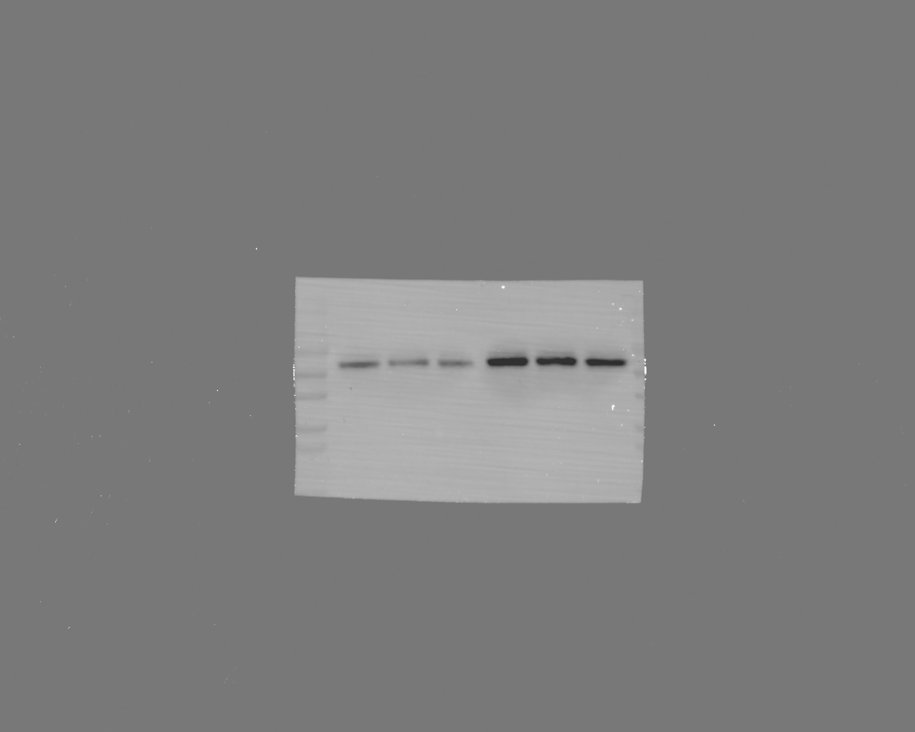
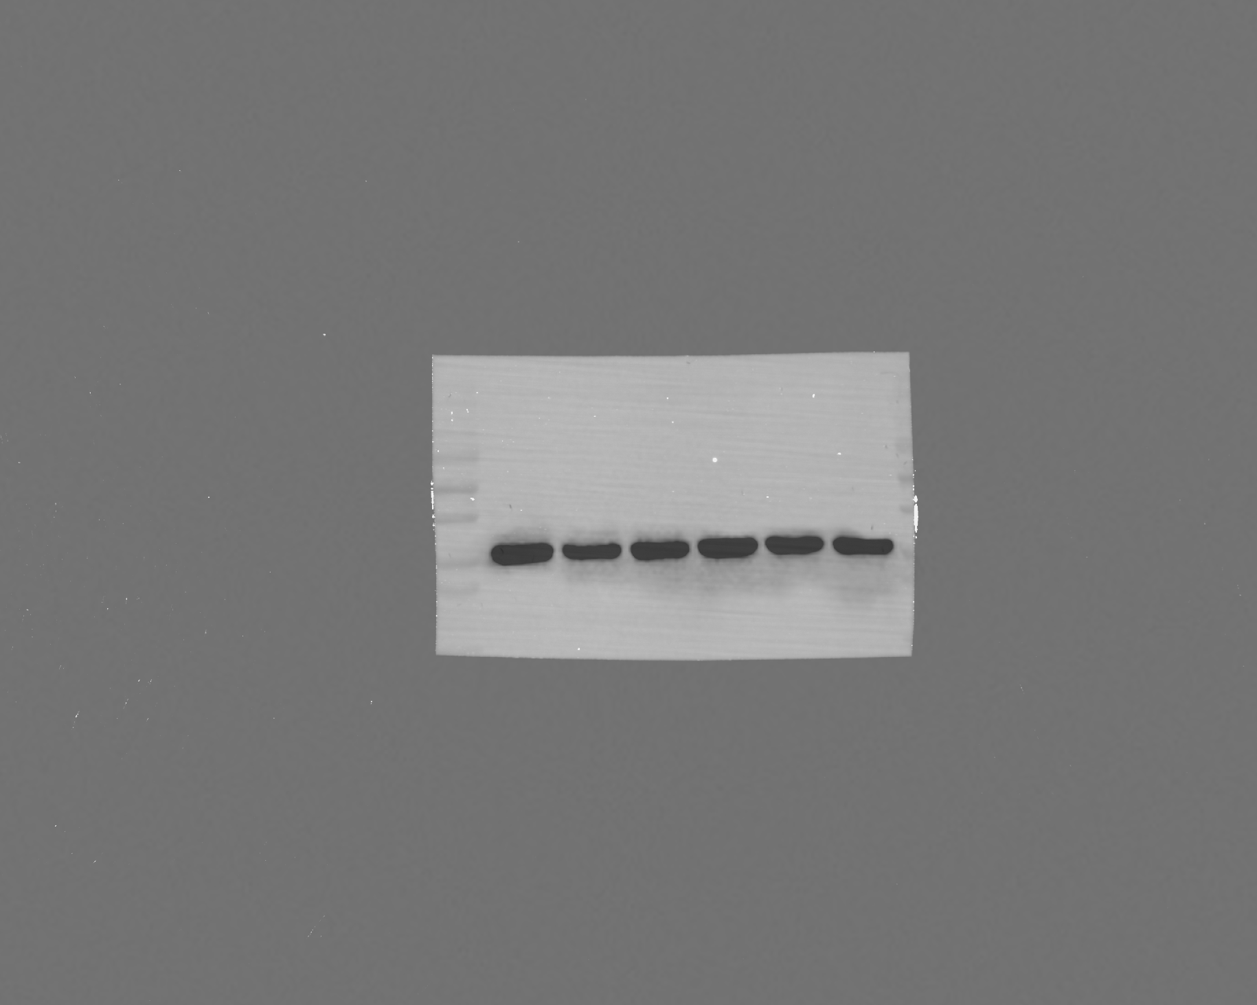
cGAS
GAPDH
Si-NC
Si-EBI3
Si-NC
Si-EBI3
100
100
70
70
59 kDa
55
55
40
37 kDa
40
35
35
25
25
15
15

Slide 2
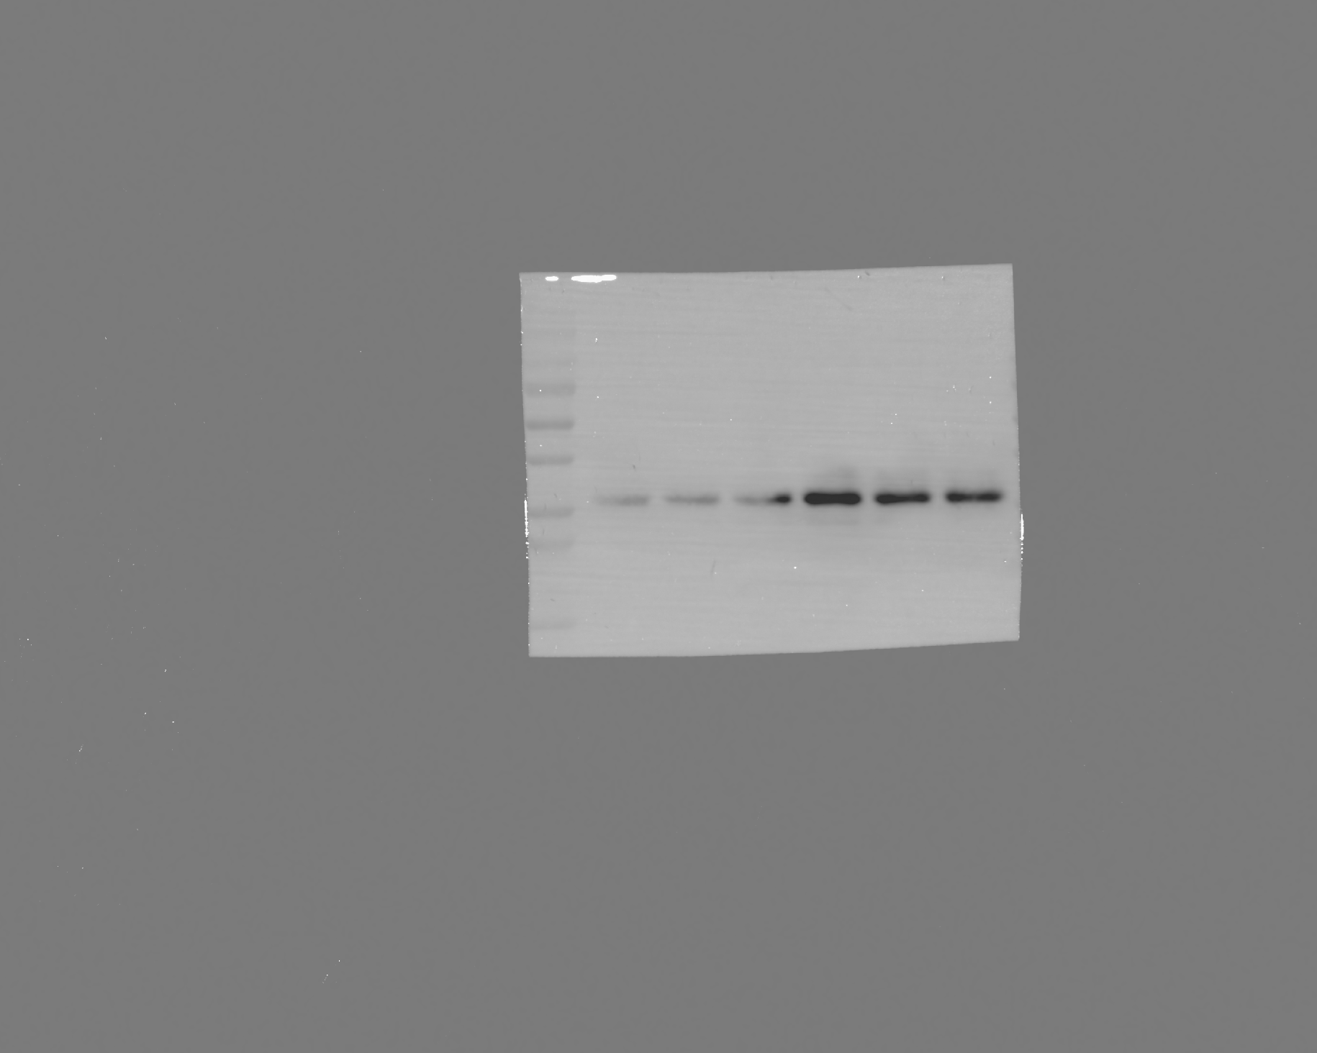
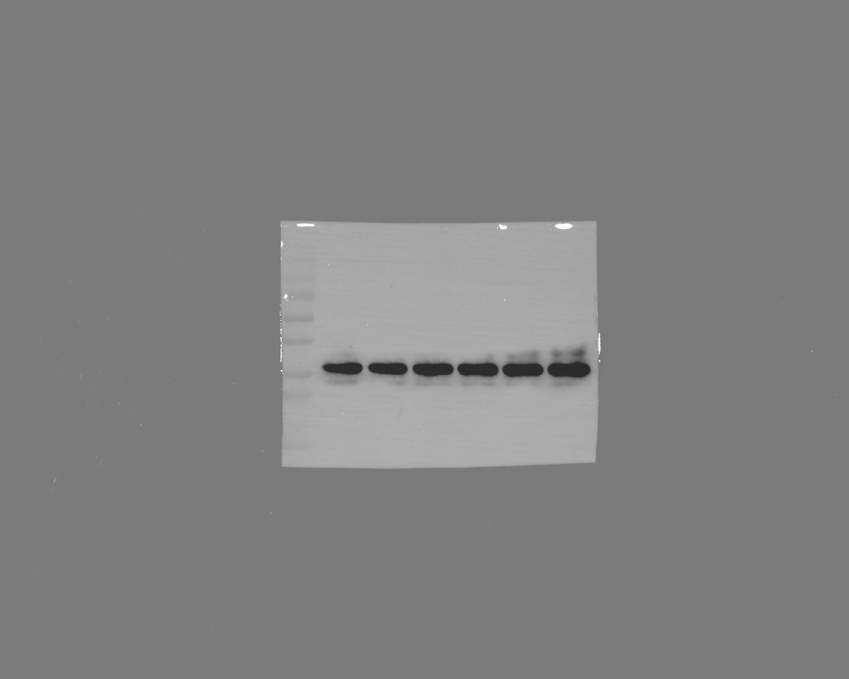
P-STING
Si-NC
Si-EBI3
STING
Si-NC
Si-EBI3
100
70
55
42 kDa
100
40
70
35
55
40
42 kDa
25
35
25

Slide 3
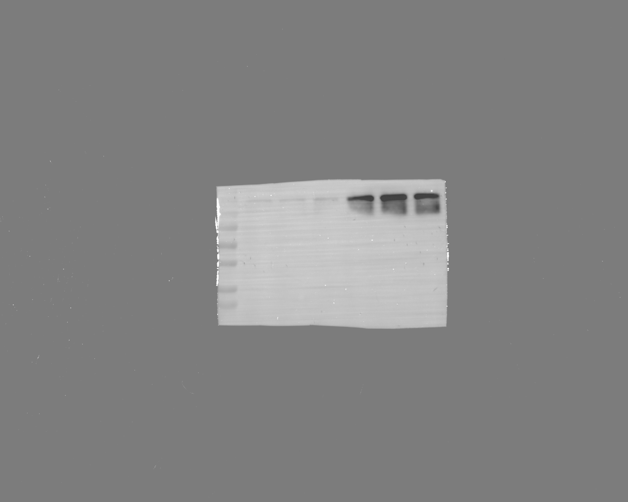
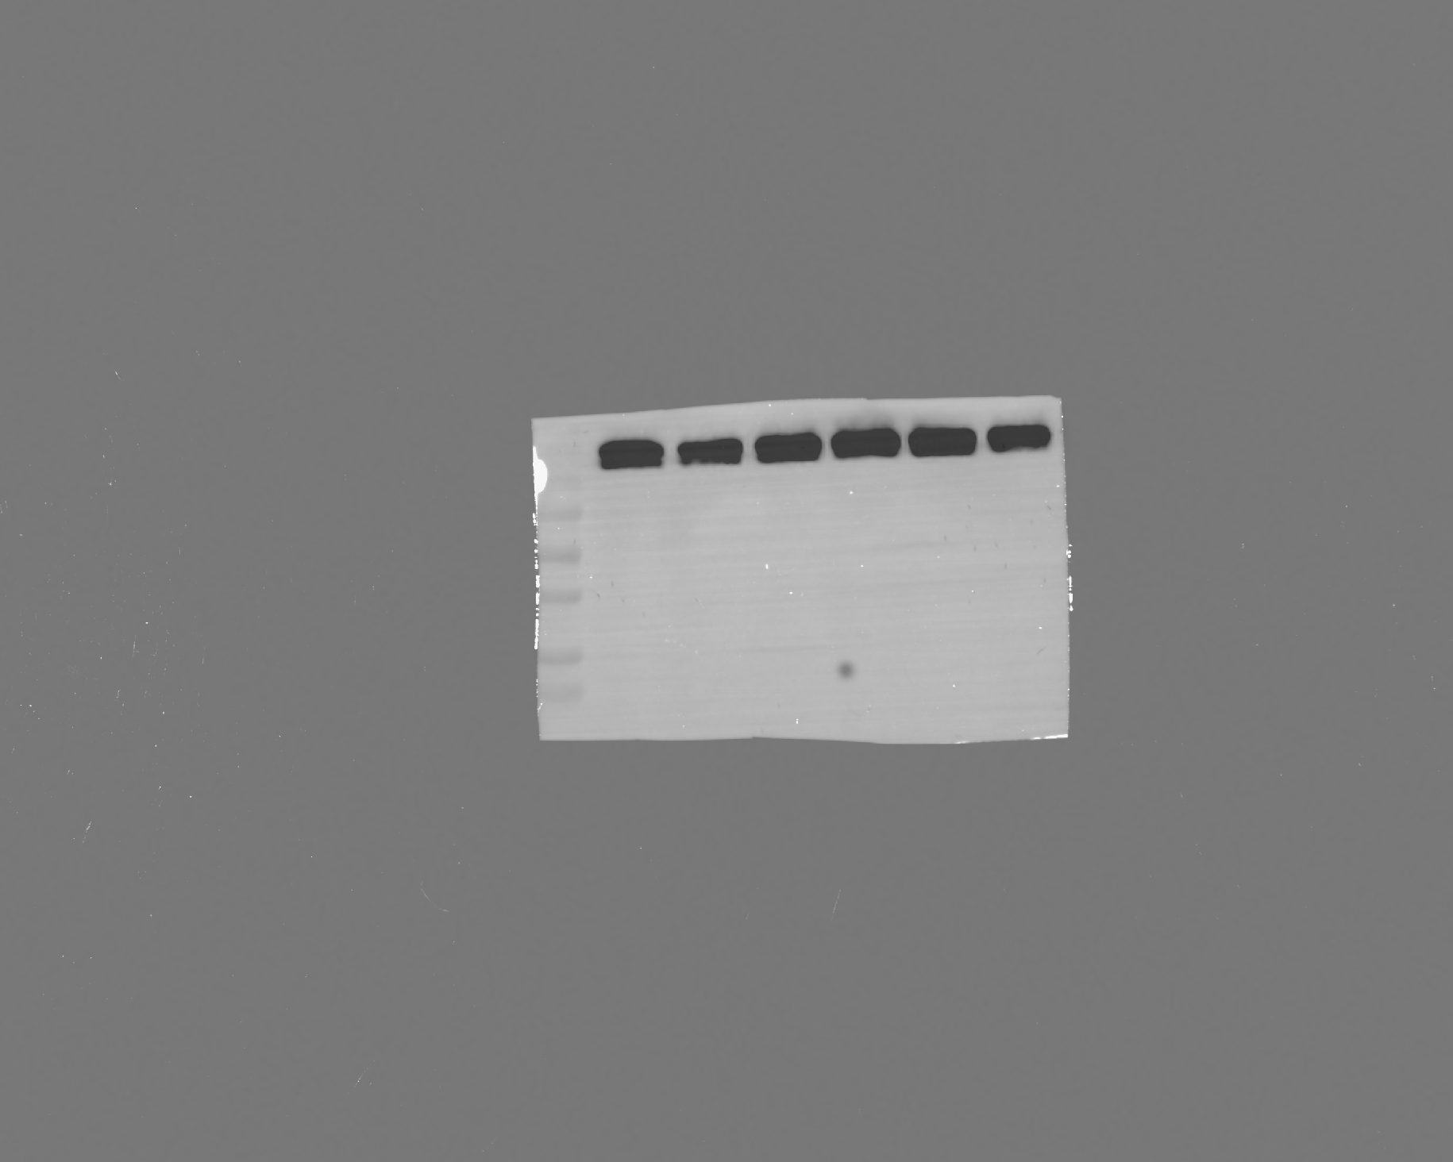
P-IRE1a
IRE1a
Si-NC
Si-EBI3
Si-NC
Si-EBI3
107 kDa
110
107 kDa
110
100
100
70
70
55
55
40
40
35
35
25
25

